Slide 1
DEPLOY WAR/EAR FILE INTO TOMCAT SERVER BY USING JENKINS

Slide 2
INTRODUCTION
TOMCAT: A Java-based web server and servlet container. It's mainly used to host Java web applications, providing an environment to run applications that respond to web requests, like a website or API. If you need a server to handle HTTP requests and serve applications to users, Tomcat is your choice.
JENKINS: Jenkins is an open source automation server primarily used for continous integration and continous delivery (CI/CD) in software development. It helps to automate repetitive tasks such as building, Testing and deploying applications.
MAVEN: Maven is a tool that helps Java developers automate the process of building, testing, and managing their projects. It handles tasks like downloading libraries (dependencies), compiling code, running tests, and packaging the final application.

Slide 3
STEPS TO DEPLOY
STEP-1: CREATE TWO INSTANCES i.e., one instance for Jenkins installation and the other for tomcat installation.
STEP-2: Connect the Jenkins instance with gitbash/linux/putty then run the following command.
sudo su
sudo dnf update -y
yum list java*
sudo dnf install -y java-17-amazon-corretto.x86_64
sudo wget -O /etc/yum.repos.d/jenkins.repo https://pkg.jenkins.io/redhat-stable/jenkins.repo
sudo rpm --import https://pkg.jenkins.io/redhat-stable/jenkins.io-2023.key

Slide 4
yum install jenkins
service jenkins start
systemctl start jenkins
systemctl status jenkins
cat <link>
readlink -f $(which java): By giving this command in the git bash we will be getting JDK path like this /usr/lib/jvm/java-17-amazon-corretto.x86_64/bin/bash
From this path remove bin/bash. Then paste the remaining path obtained in the JDK section wherever you need
/usr/lib/jvm/java-17-amazon-corretto.x86_64

Slide 5

Install the Required plugins and get connect to dashboard
STEP-3: Maven should be there in your local system
STEP-4: Connect the Tomcat instance with gitbash/linux/putty then run the following commands
wget https://dlcdn.apache.org/tomcat/tomcat-9/v9.0.96/bin/apache-tomcat-9.0.96.tar.gz
ls

Slide 6

tar xvzf <give the unzip file that is displayed in the above image>
ls
rm -rf <give the unzip file link over here>
ls --> By giving ls command we can see that the unzip file has been deleted.

Slide 7
mv apache-tomcat-9.0.96 tomcat --> mv command will change the file name from original name. Here I am changing “apache-tomcat-9.0.96” to “tomcat” as shortform
cd tomcat à Changing to tomcat directory
yum install java -y --> Install java
ls -->The following files and directories gets displayed
cd conf --> Navigating into the conf directory
ls

Slide 8
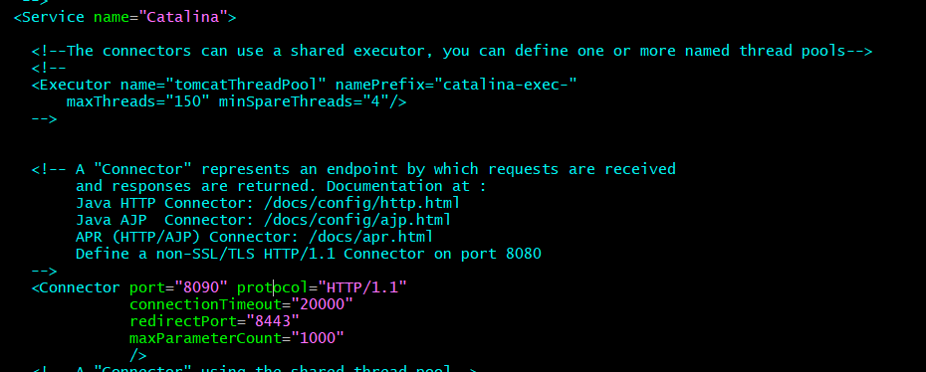
vi server.xml --> vi editor gets opened and here we need to change the port. The default port will be 8080. As we are opening Jenkins in the same port the tomcat port needs to be changed. Here I have changed the port to 8090.

Slide 9
cd .. --> from the conf directory we are getting back to tomcat directory
cd bin
ls --> The files and directories in the bin gets displayed. Like this when we navigate in to any directory we can check the inside files and directories by giving ls command.
sh shutdown.sh
sh startup.sh
cd .. --> From bin dir we will go back to tomcat dir.
cd conf

Slide 10
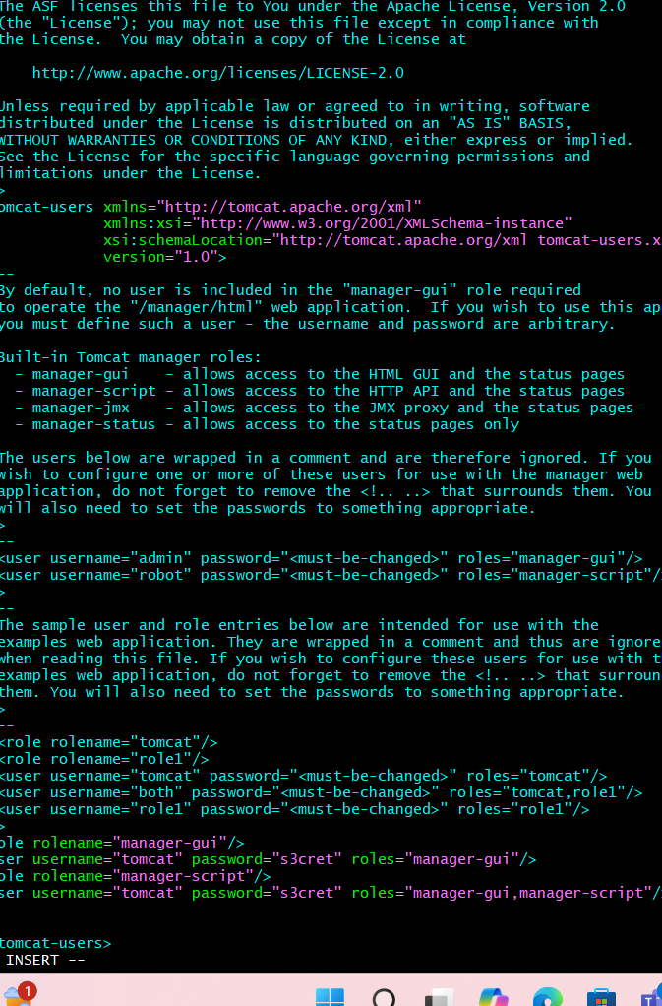
ls
vi tomcat-users.xml
<role rolename="manager-gui"/> <user username="tomcat" password="s3cret" roles="manager-gui"/> <role rolename="manager-script"/> <user username="tomcat" password="s3cret" roles="manager-gui,manager-script"/>
Add the given roles, username and password as shown in the figure

Slide 11

cd .. --> From conf getting back to tomcat dir
cd bin --> Navigate to bin
sh shutdown.sh
sh startup.sh
cd .. --> From bin getting back to tomcat dir
ls
cd webapps àNavigate to webapps
ls

Slide 12

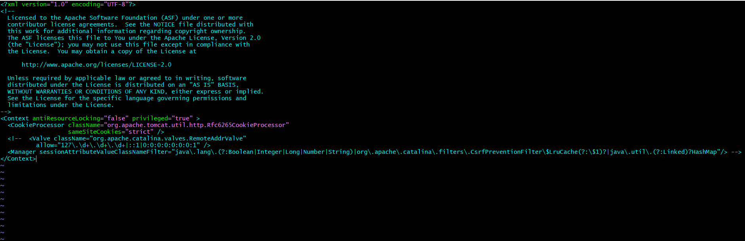
cd manager --> Navigate to manager
ls
cd META-INF --> Navigate to META-INF
ls
vi context.xml

Slide 13
Add <!-- symbol before Valve and “-->” symbol after HashMap to disable it.
cd .. --> back to manager dir
cd .. --> back to webapps dir
cd .. --> back to tomcat dir
cd bin --> after getting into tomcat dir we will get navigate to bin dir
sh shutdown.sh
sh startup.sh --> Tomcat gets started

Slide 14
STEP-5: In the Jenkins Dashboard go to manage jenkins and install some plugins like
Deploy to container
Pipeline API
Full stage view pipeline
GIT server
Maven Integration
STEP-6: Go to manage Jenkins --> Systems --> Global properties --> Environment variables --> Under the name section add JAVA_HOME and value as /usr/lib/jvm/java-17-amazon-corretto.x86_64 (Give your java path which you have installed)

Slide 15
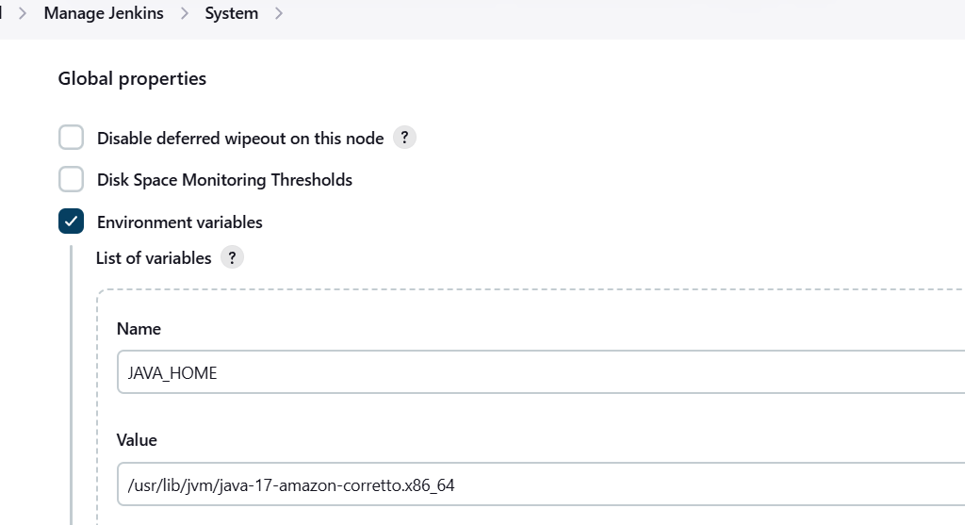

Slide 16
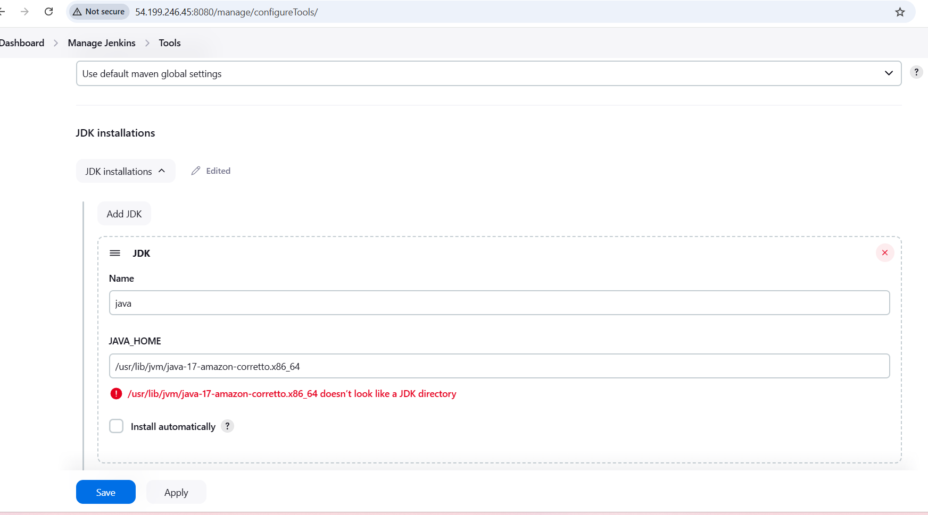
STEP-7: Again manage Jenkins --> Tools --> jdk installations --> Name:java -->
JAVA_HOME: /usr/lib/jvm/java-17-amazon-corretto.x86_64

Slide 17
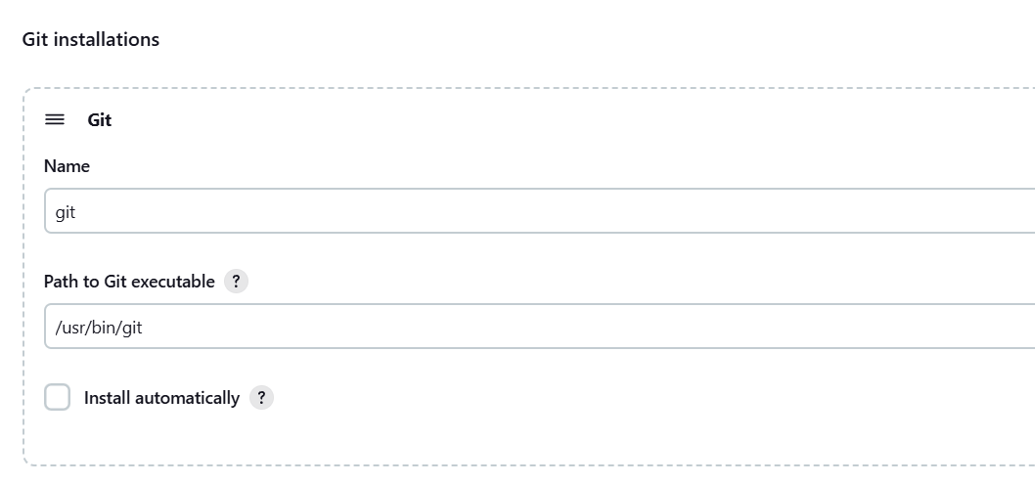
STEP-8: Manage Jenkins --> Tools --> Git installations --> Name: git --> Path: user/bin/git
**To know the git path use the command “ which git “ in the git bash. Then it shows the path.**

Slide 18
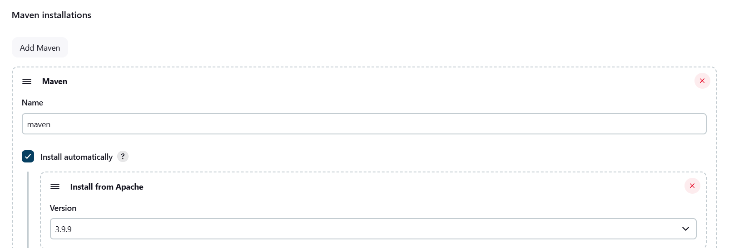
STEP-9: Manage Jenkins --> Tools --> Maven Installations --> name should be selected from dropdown --> and the version should be given that has been installed in our local system
In my case I have installed 3.9.9 version
Click on Save and apply

Slide 19
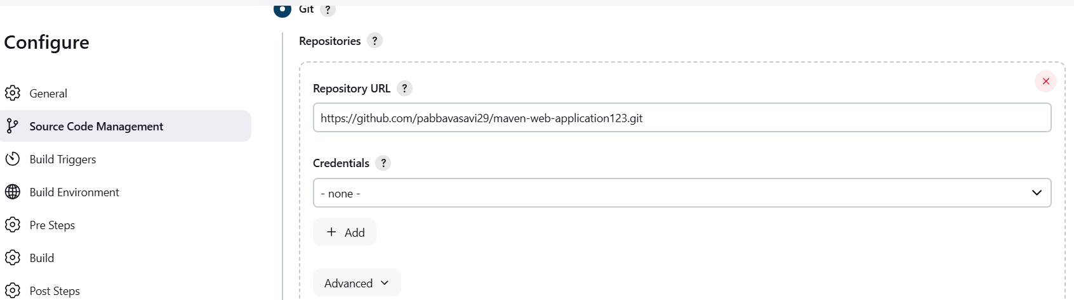
STEP-10: Jenkins dashboard --> New Item --> Give some name --> Select maven Project --> Click on ok
STEP-11: Under the source code management select Git and add repository url. Also specify the default branch of that repository i.e., */master or */main
GIT URL: https://github.com/pabbavasavi29/maven-web-application123.git

Slide 20
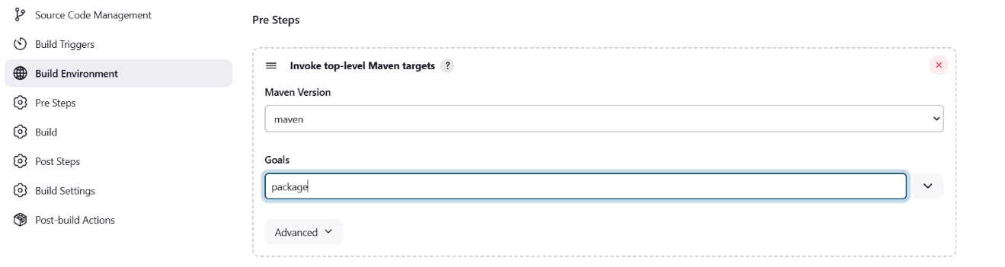
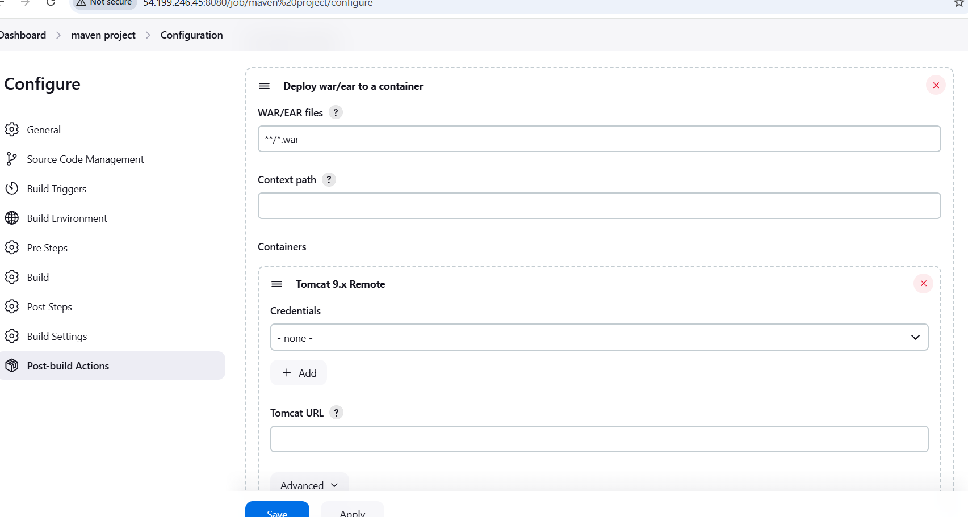
STEP-12: Pre-steps --> Invoke top level maven targets --> select maven version from dropdown --> add package under the goals section
STEP-13: Post-Build actions --> select deploy war/ear to a container from the dropdown --> under the WAR/EAR files section give **/*.war

Slide 21
STEP-14: In the same section add tomcat credentials i.e., username and password which we have added in the tomcat-users.xml file.
In my case username is tomcat
password is s3cret.
Give the Public Ip of our tomcat instance in the ID and description section
And click on add. Then the credentials gets added

Slide 22
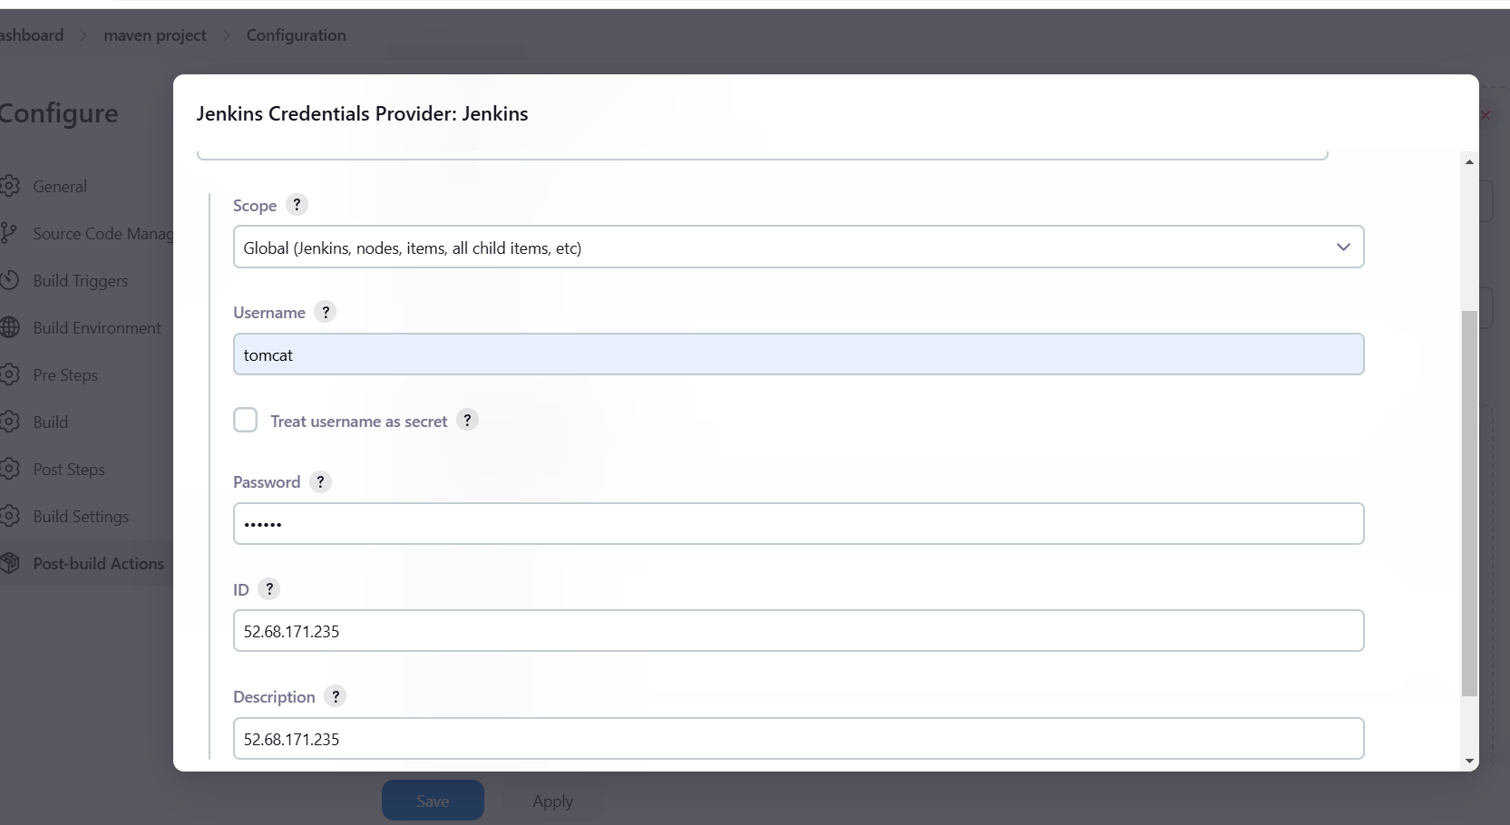
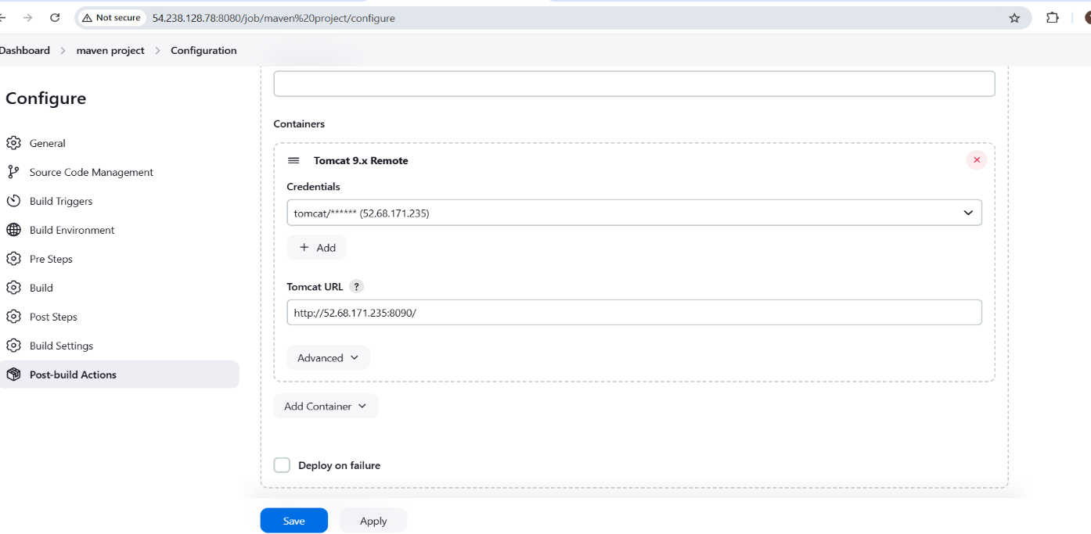

Slide 23
After adding Credentials we have to select the added credentials from the dropdown in the CREDENTIALS section and also we have specify tomcat url in the TOMCAT URL section.
STEP-15: Click on save and apply
STEP-16: Build now

Slide 24
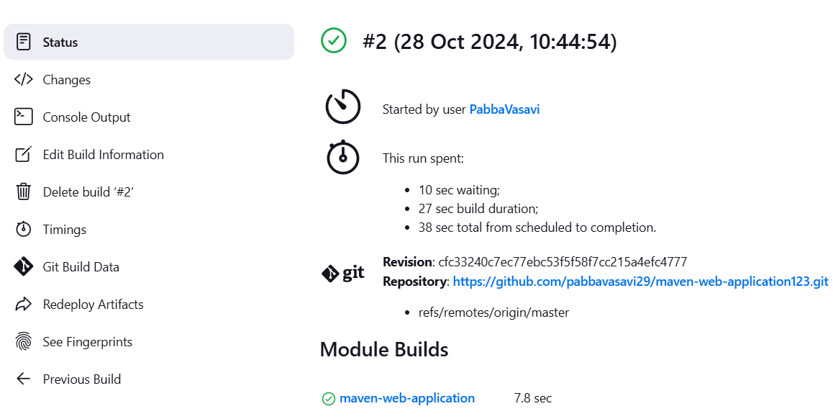
STEP-17: Check the status of the project.

Slide 25
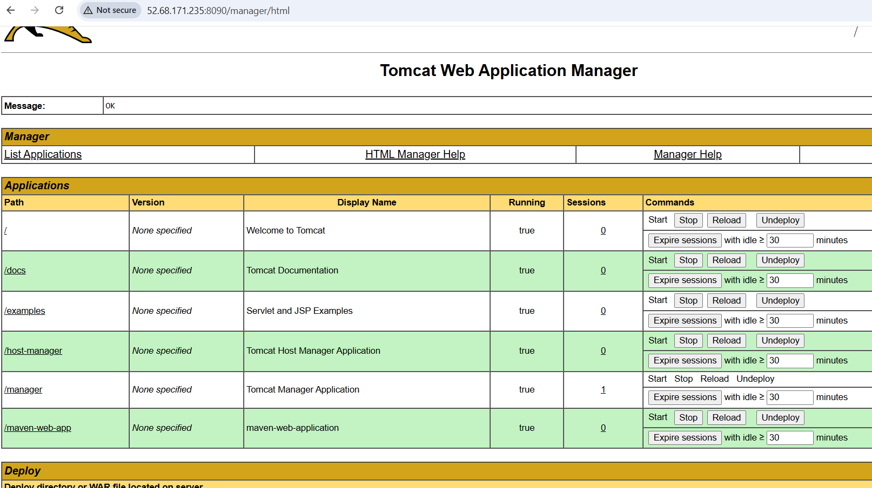
STEP-18: After Successful completion of the build navigate to tomcat dashboard --> Click on Manager-apps --> It will asks for username and password that we have mentioned in the credentials section --> If our application gets succeed it gets reflected in the dashboard as shown in the figure.

Slide 26
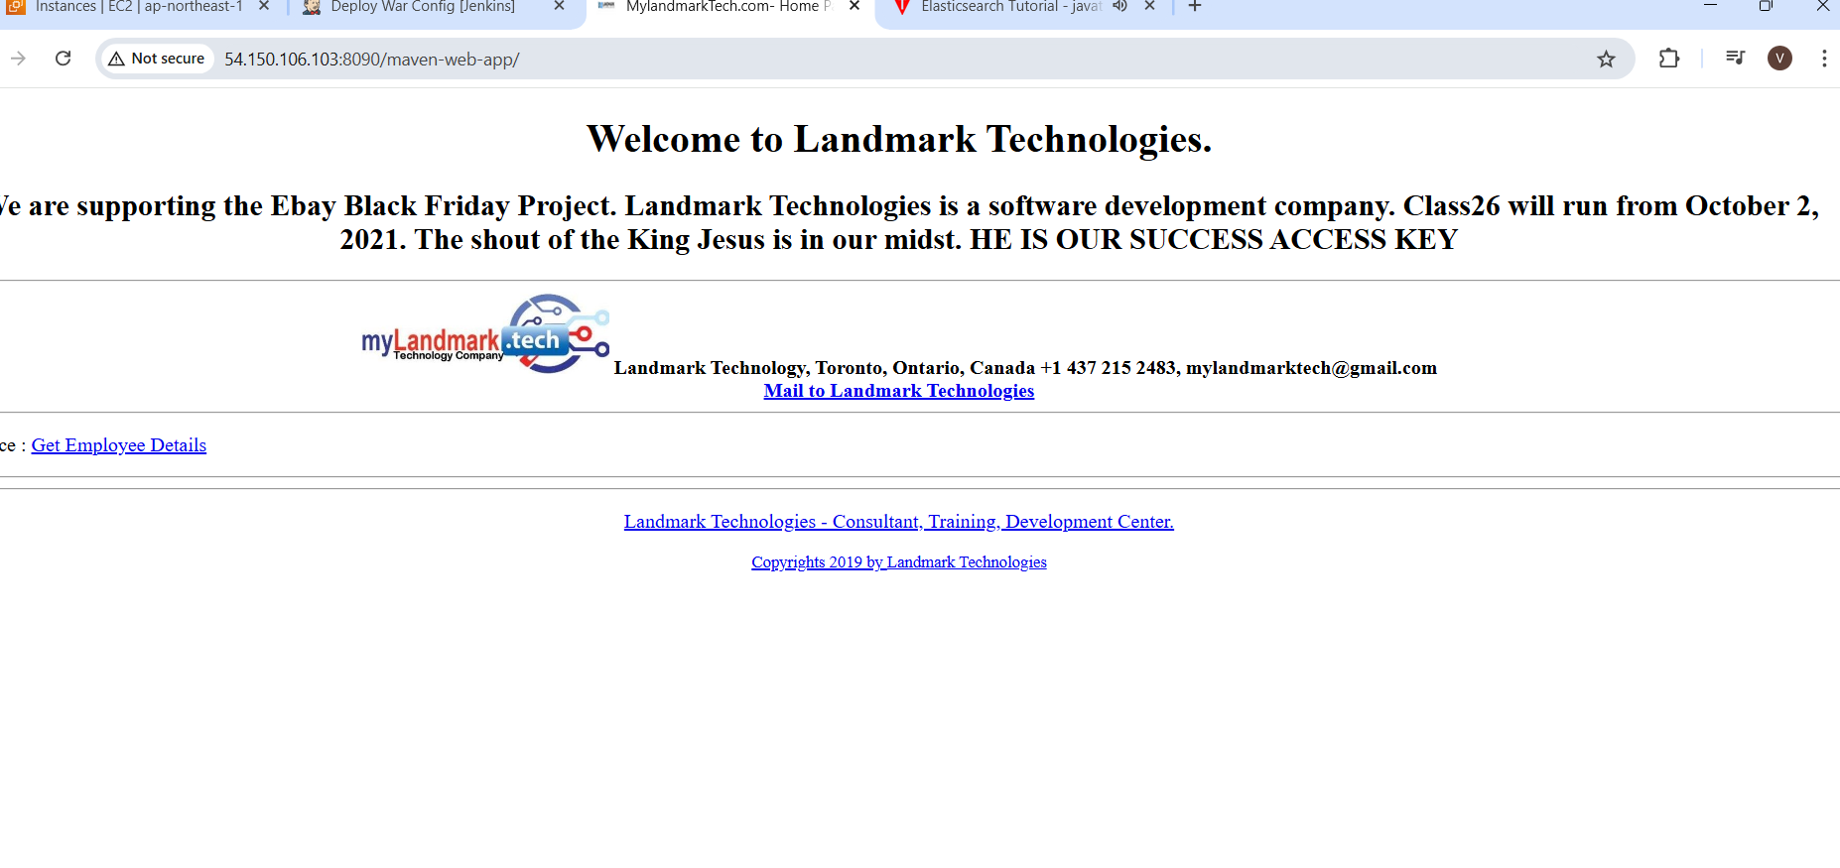
Here we can see maven-web-app application that has been reflected. Just give a click on the displayed application of your dashboard. We can see the output in the dashboard.

Slide 27
CONCLUSION
We will pull the code from SCM(Git) --> Integrate with Jenkins --> Jenkins gets interacts with maven as it is a build tool --> Here we will build a WAR/JAR FILE -->After successful build of WAR/JAR file we will deploy the file in Tomcat server.

Slide 28


